Slide 1

50.039 Theory and Practice of Deep Learning W11S3bis – About ChatGPT and Large Language Models (LLMs)
Matthieu De Mari

Slide 2
About this week (Week 11bis – ChatGPT/LLMs)
What are Large Language Models?
What is ChatGPT?
What are the different elements composing the ChatGPT model and how do they relate to the concepts we have seen in previous weeks?
How was ChatGPT trained using a mix of Deep Learning and Reinforcement Learning with Human Feedback?

Slide 3
Large Language Models
Definition (Large Language Models):
Large Language Models (LLMs) are a class of machine learning algorithms designed to understand, interpret, and generate human language. They are based on probabilistic methods that capture the statistical structure of text data, allowing them to generate text that appears coherent and contextually relevant.
Similar to the Word and Sentence Embedding Problem in Week 8!

Slide 4
Large Language Models
The development of language models has been significantly influenced by the introduction of Deep Learning techniques.
DL facilitates the creation of more sophisticated and expressive models, capable of generating text that resembles human-written content.
These LLM models have become the essential components in various NLP tasks (machine translation, sentiment analysis, text summarization, text generation, and conversational AI systems).
Typically used for embedding text, enabling machines to understand and communicate with humans more effectively.

Slide 5
The ChatGPT ML problem
ChatGPT is a model used in a typical task of NLP, which is designing a query chatbot, answering user requests as efficiently as possible.
Like any ML problem, it consists of four elements
Task
Dataset
Model
Loss and Training Procedure

Slide 6
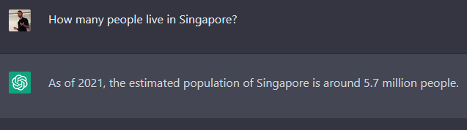
The ChatGPT ML problem: 1. Task
Task
The ChatGPT model is one of the many models, specifically designed to engage in meaningful conversations with users, allowing for the generation of coherent, contextually relevant, and informative responses.
Other examples: Bard AI (Google), LLaMA (Facebook), Claude, etc.
LLaMA: https://ai.facebook.com/blog/large-language-model-llama-meta-ai/
Google Bard: https://bard.google.com/
ChatGPT: https://chat.openai.com/chat

Slide 7
The ChatGPT ML problem: 2. Dataset
Dataset
The pre-training dataset for ChatGPT consists of a vast collection of text data from diverse sources, such as books, articles, websites, and social media posts.
The purpose of using a large and varied dataset is to ensure that the model learns a broad understanding of language, encompassing different styles, topics, and contexts.
Must be designed to expose the model to a wide variety of linguistic patterns, contexts, and domains, enabling it to learn the complexities and nuances of human language.
To achieve this, the dataset must be large and diverse, containing text from numerous sources that reflect the many ways language is used.

Slide 8
The ChatGPT ML problem: 2. Dataset
Dataset
The primary source of data for ChatGPT is the WebText dataset, which consists of approximately 8 million web pages collected from the internet, such as news articles, websites, and online forums.
This diversity helps to ensure that the model is exposed to a broad range of language and writing styles, which is essential for generating human-like text.
Typically, we want the text in the dataset to be written by people for different purposes and with different writing styles.
Also, constantly updated with new data. When new web pages are added to tracked websites, they are included in the dataset, which helps to ensure that the model is trained on the most recent and relevant language data.

Slide 9
The ChatGPT ML problem: 2. Dataset
Dataset
Also, some additional datasets were used. These include a variety of text sources such as books, articles, and other written works.
The exact sources of these datasets were not publicly disclosed by OpenAI, but we suspect something similar to what was used for the other models we discussed in W8S1-2, i.e. Word2Vec, FastText, etc.

Slide 10
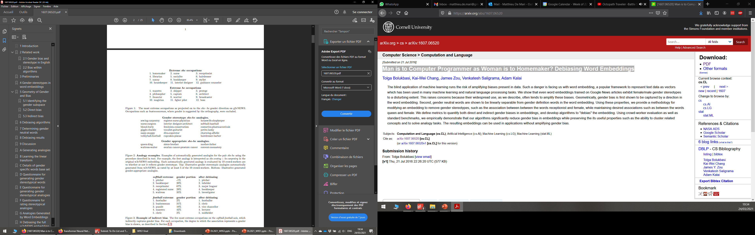
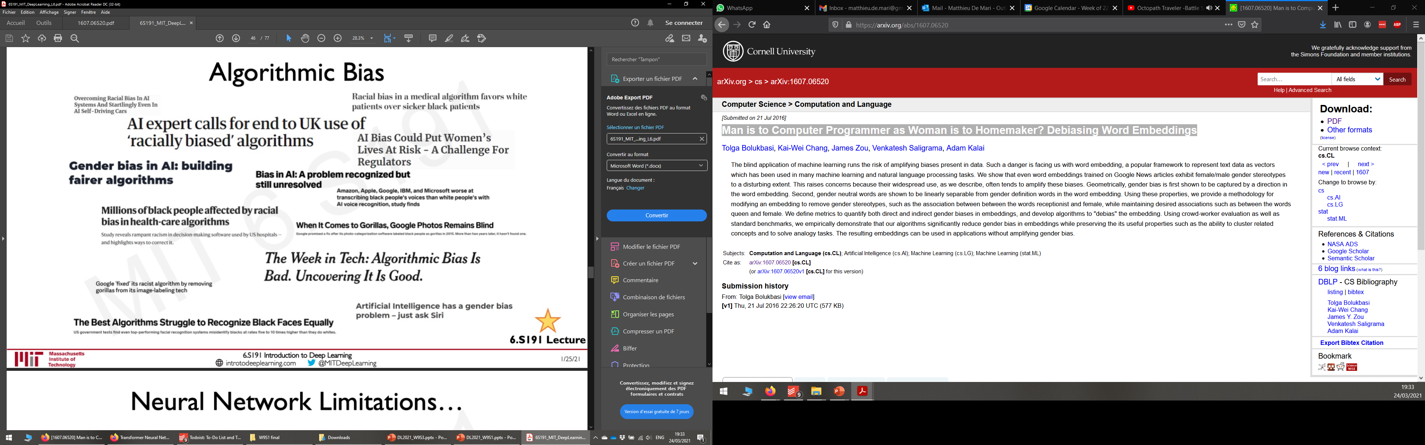
The ChatGPT ML problem: 2. Dataset
Dataset
Should also carefully curate and filter the dataset to minimize biases (racism, violence, etc.), aiming to provide a representative sample of human language that is both balanced, comprehensive and safe.
Remember W8S3 about Word Embedding biases!

Slide 11
The ChatGPT ML problem: 2. Dataset
Dataset
Also used Data Augmentation!
Typically, text manipulation, e.g.
Synonym replacement,
Random insertion,
Random deletion,
Random swapping of words,
Text-to-speech conversion,
Etc.
(Discussed on W4 for images)
Also, back-translation, which is the process of translating a sentence from one language to another, and then translating it back to the original language.
Can be especially useful for training models on multilingual data, as it can help the model to learn the nuances of different languages and cultures.
Allow the model to learn from a wider range of language styles and structures.

Slide 12
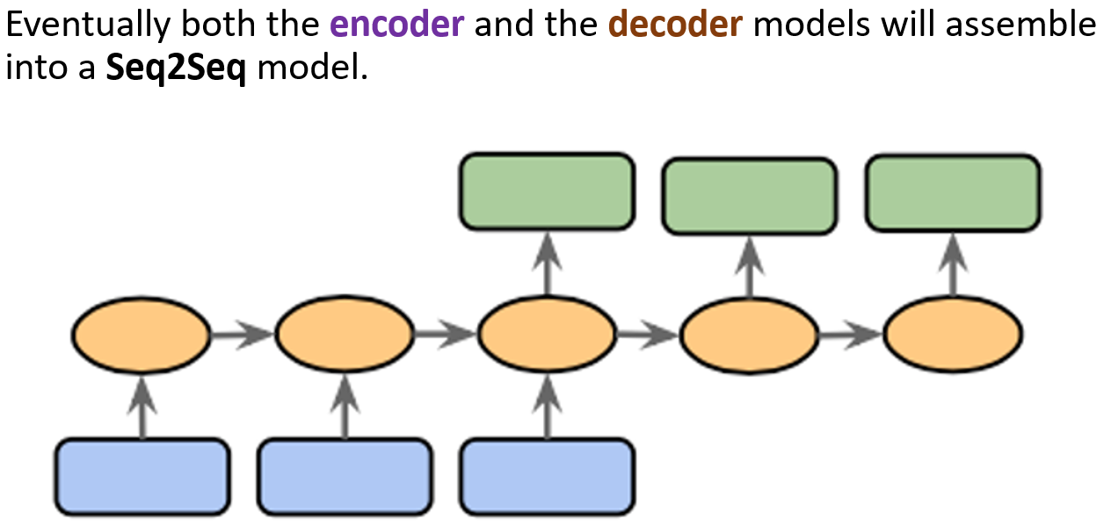
The ChatGPT ML problem: 3. Model
Model
ChatGPT is another typical encoder-decoder model, or Seq2Seq model.
Both the inputs and the outputs can be seen as sequential data.
Typically discussed in W6S2 and Week 8 lectures.

Slide 13
The ChatGPT ML problem: 3. Model
Model
The model input here consists of the user prompt, in the form of sequential text.
It also includes a memory vector, containing information about previous queries and answers.
The encoder part should combine all elements and encode the meaning of the user query into a numerical vector describing the meaning of that request.

Slide 14
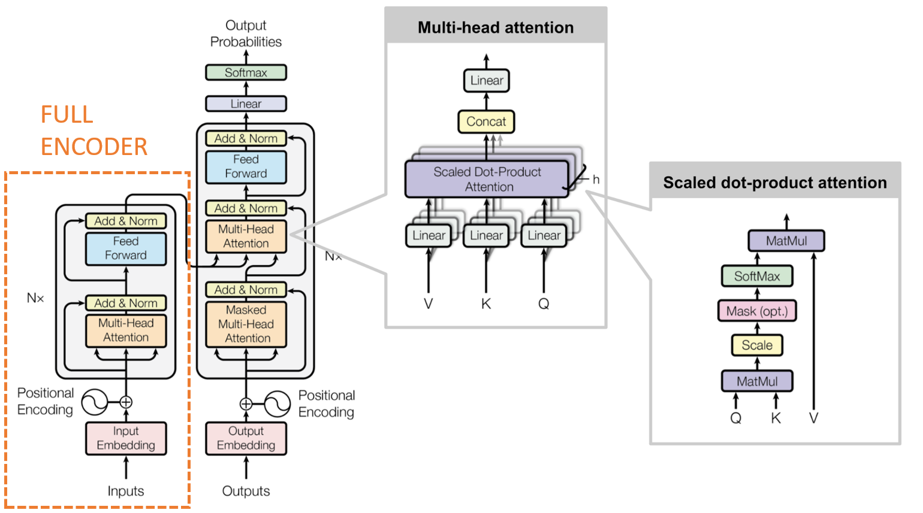
The ChatGPT ML problem: 3. Model
Model (Encoder)
The encoder part of ChatGPT relies on the GPT idea discussed in W8S3.
Transformer-based model,
Will process an input consisting of a sequence of words,
And will produce an encoding vector.
As in W8S3 on Transformers architectures (Encoder part).

Slide 15

FULL
ENCODER

Slide 16
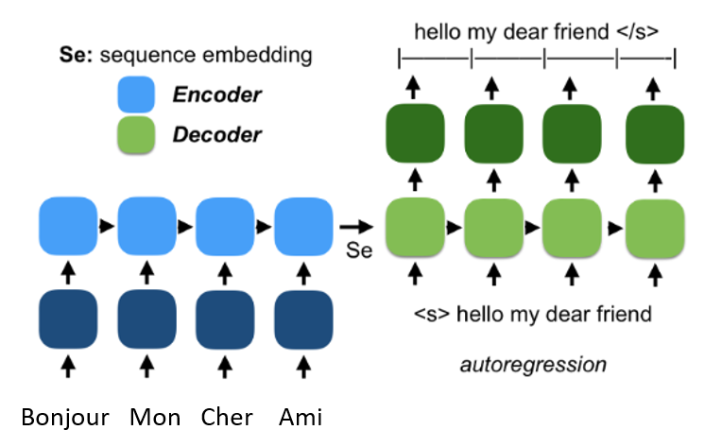
The ChatGPT ML problem: 3. Model
Model (Decoder)
The decoder part of ChatGPT relies on the auto-regressive models, that are trying to predict the next word to use in sentence and constructs an answer, one word at a time.
Will use the encoding vector as a memory vector for the autoregressive RNN used in the decoder part!

Slide 17
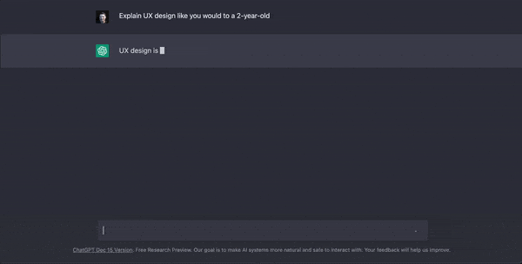
The ChatGPT ML problem: 3. Model
Model (Decoder)
Typically, ChatGPT uses autoregressive RNNs in its decoder part!
Takes a sequence of words as input (user query), encodes it as a vector using a transformer-based model.
And then reconstructs an answer, a sentence, one word after the other!

Slide 18
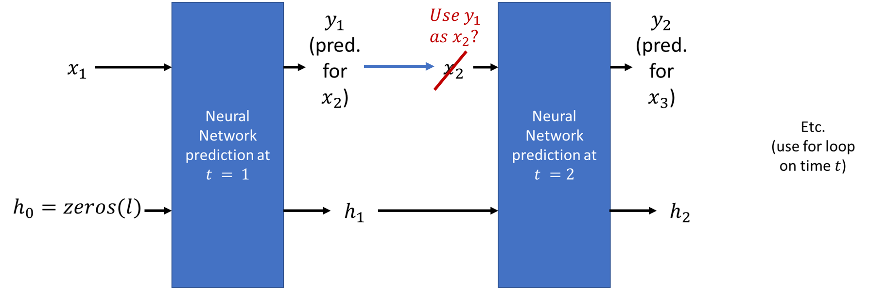
The ChatGPT ML problem: 3. Model
Model (Decoder)
Commonly referred to as token prediction:
At each time step, the model predicts the next token in the sequence based on the context provided by the previous tokens.
The final layer of the Transformer produces a probability distribution over the entire vocabulary, and the next token is selected based on this distribution.
Also updates the encoding vector, to update which parts of the query the answer as already covered, RNN-style! (W6S2).

Slide 19
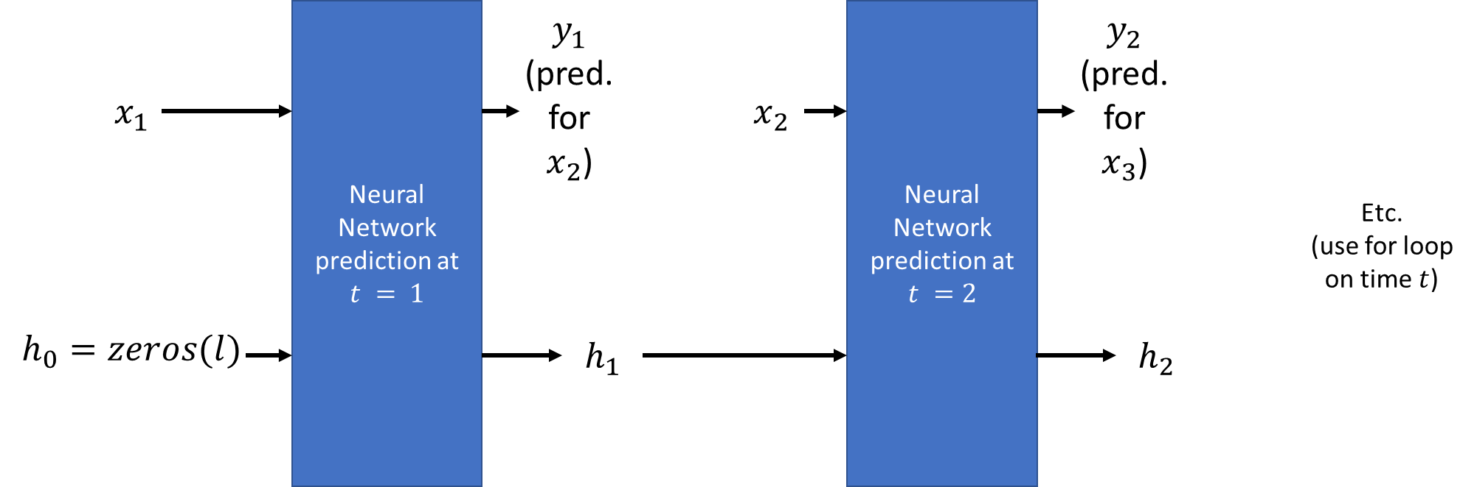
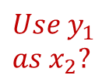
A quick word on autoregressive RNNs
$$Use y_{1}$$
$$as x_{2}?$$

Slide 20
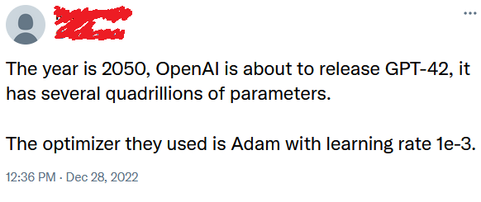
The ChatGPT ML problem: 4. Loss/Training
4. Loss and Training
At the end of the day, the token prediction task is a classification one (predicts from a finite number of words/characters)
The primary objective function for training is most likely a Maximum Likelihood Estimation (MLE) or something similar.
ChatGPT relies on advanced optimizers, such as the Adam optimizer. (Week 2!)

Slide 21
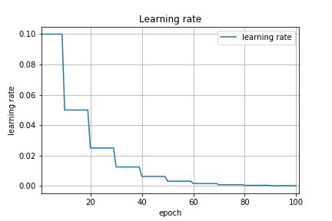
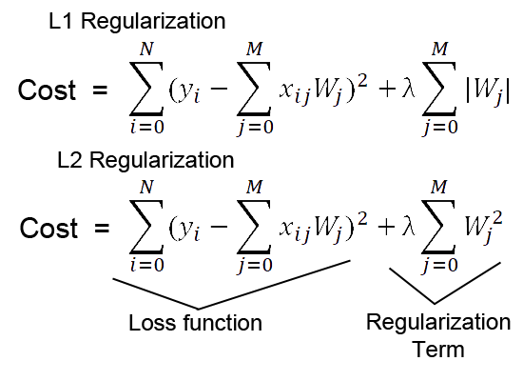
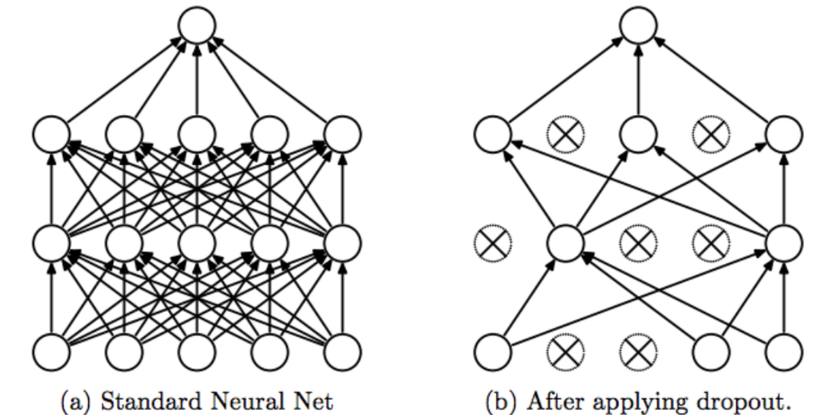
The ChatGPT ML problem: 4. Loss/Training
4. Loss and Training
Also used some learning rate scheduling/decay (Week 2), according to their paper.
Regularization (Week 1) also used, in the form of weight decay, which adds a penalty term to the loss function based on the magnitude of the model's parameters.
Also used dropout (Week 4) as regularization, during training.

Slide 22
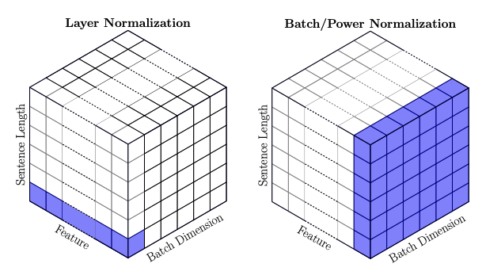
The ChatGPT ML problem: 4. Loss/Training
4. Loss and Training
Layer normalization (Week 4) is also applied within the Transformer architecture to stabilize the training process.
Similar to BatchNorm (Week 4), it normalizes the inputs to each layer, ensuring that they have a consistent mean and variance.
This approach helps prevent the vanishing or exploding gradient problems (Week 2).

Slide 23
The ChatGPT ML problem: 4. Loss/Training
4. Loss and Training
As for evaluation…
During the training process, various evaluation metrics are used to monitor the model's performance and progress.
These typical NLP metrics include
Perplexity, which is used to measure of how well the model predicts the next token in a sequence,
and task-specific NLP metrics for fine-tuning, such as F1 score, BLEU score, or ROUGE score.
You will learn more about these metrics in NLP Term 7 course!

Slide 24
Fine-tuning the model
Fine-tuning is a crucial step in the development of models like ChatGPT, as it adapts the pretrained model to specific tasks or domains.
Pretraining exposes the model to a wide range of language patterns and helps it learn general language understanding.
Fine-tuning, on the other hand, tailors the model to perform specific tasks, such as answering questions, summarizing text, or generating contextually relevant responses in a conversation.
By fine-tuning the model on a more narrow and controlled dataset, it becomes more accurate, reliable, and safe to use in specific applications.

Slide 25
Fine-tuning the model
Models like ChatGPT have typically benefited from fine-tuning using reinforcement learning techniques that leverage human feedback (W11S3).
RLHF involves (re-)training the (pre-trained) model using a reward function that is based on human preferences or judgments.
By collecting human feedback on model-generated outputs, a reward model can be created to evaluate the quality of the generated text.
This approach helps the model learn from real-world feedback and further improves its performance, safety, and usefulness in generating human-like responses.

Slide 26

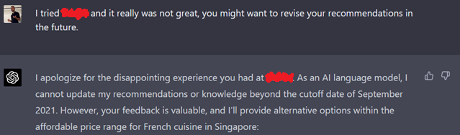
Fine-tuning the model
Typically, this also happen on-the-fly when you give feedback to the model based on its given answers!
Using the thumbs-up or thumbs-down icons,
Or by following up on the answer.
Feedback is probably integrated with a critic engine (as in W10S3 and W11S3) that tells the model how to retrain and improve!

Slide 27
Fine-tuning the model
Definition (Online Learning):
The process of fine-tuning a model based on instantaneous feedback is often referred to as online learning or incremental learning.
In online learning, the model updates its parameters as new data samples/examples arrive, allowing it to adapt to changing data distributions or to learn from new examples without the need to retrain on the entire dataset.
Online learning is particularly useful in situations where data is continuously generated or collected (e.g. a chatbot!).
It enables models to quickly adapt to new information and maintain their performance in dynamic environments.

Slide 28
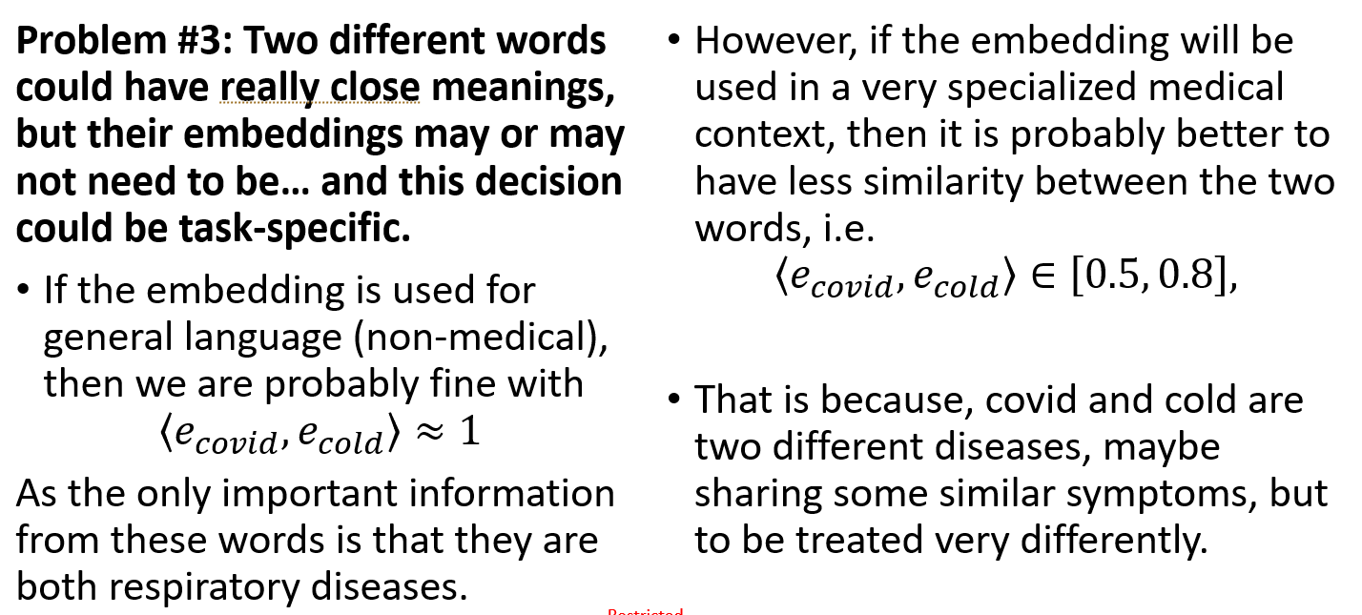
ChatGPT is multimodal
ChatGPT exhibits multimodality.
Can operate in different languages (either human, programming, etc.).
Embedding function/model to be used will most likely differ from one language/task to another.
From W8S1, about why we need different embeddings for different languages (English, French, Python, etc.) and different tasks.

Slide 29
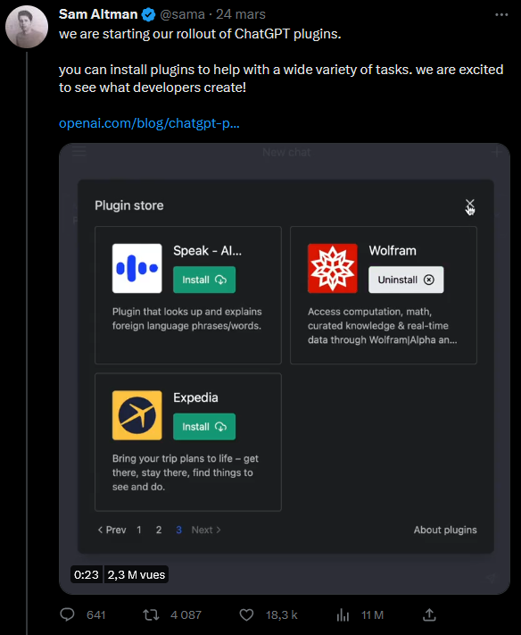
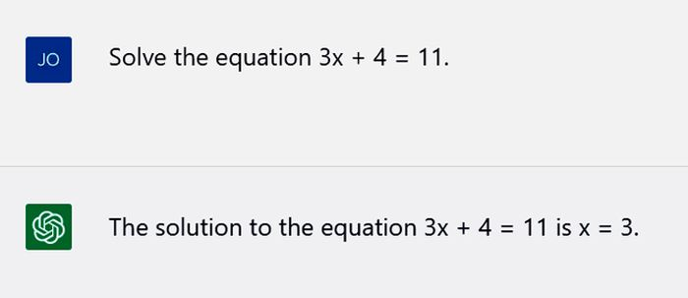
ChatGPT is multimodal
ChatGPT and other LLM chatbots are expected to become even more multimodal, for instance
By incorporating other data types, such as images or audio, alongside text.
By incorporating models trained explicitly for other tasks (e.g. Wolfram math engine for math questions/queries).
(Typically, math used to be a big issue for ChatGPT! Improving…)

Slide 30
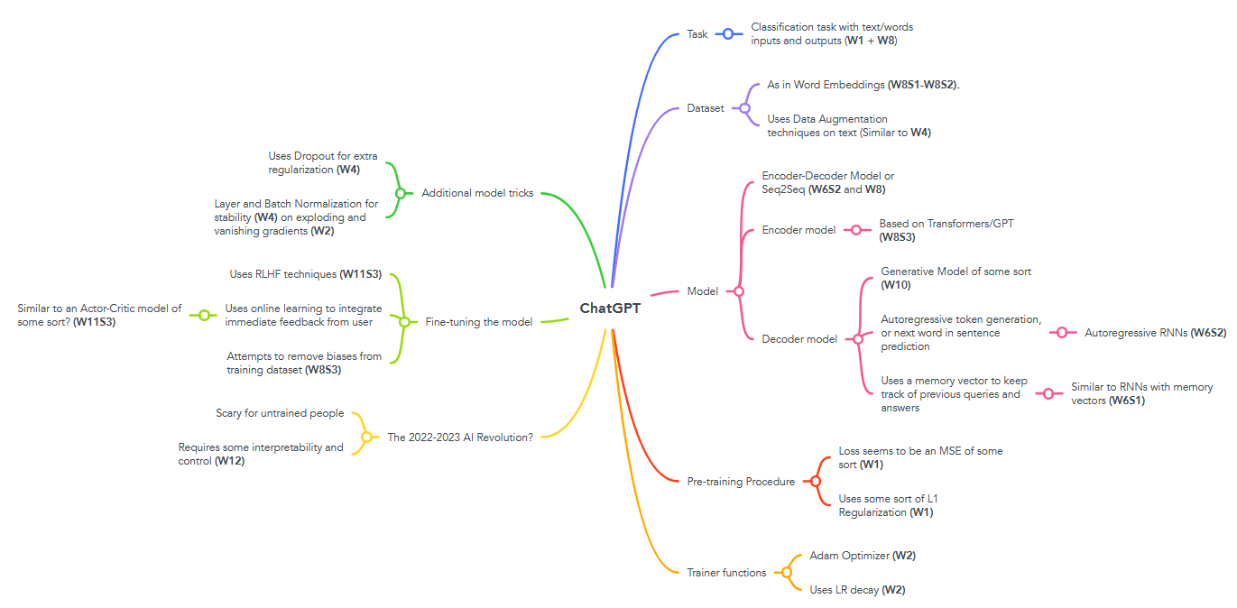
ChatGPT requires to assemble everything we know and learnt about Deep Learning this term

Slide 32
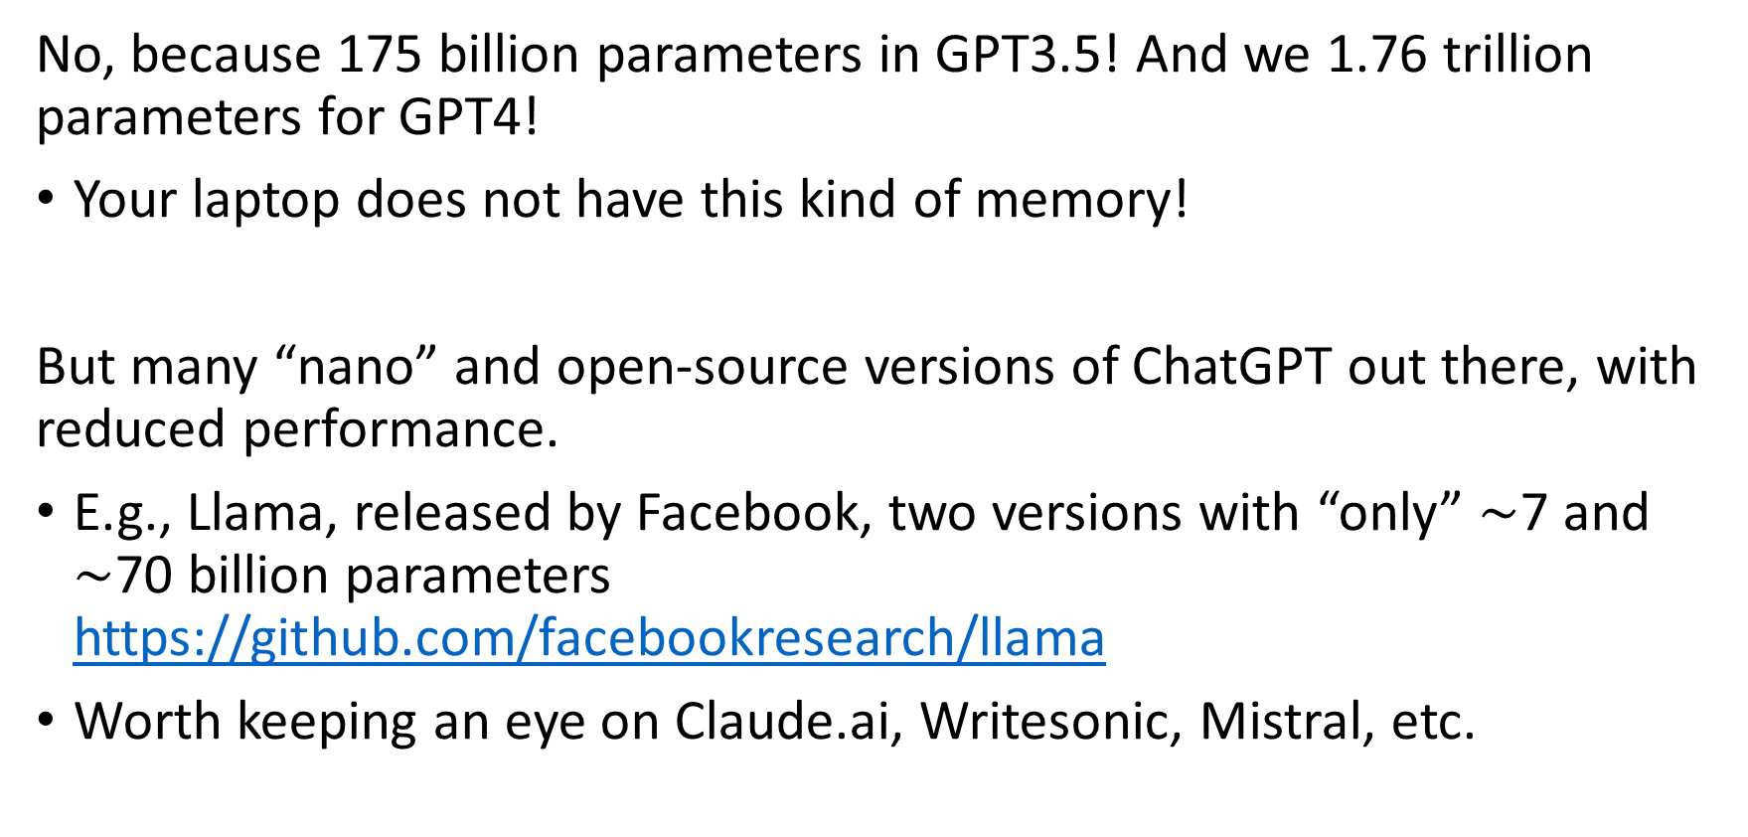
Can I recreate ChatGPT and run it?
No, because 175 billion parameters in GPT3.5! And we 1.76 trillion parameters for GPT4!
Your laptop does not have this kind of memory!
But many “nano” and open-source versions of ChatGPT out there, with reduced performance.
E.g., Llama, released by Facebook, two versions with “only” $\sim$7 and $\sim$70 billion parameters https://github.com/facebookresearch/llama
Worth keeping an eye on Claude.ai, Writesonic, Mistral, etc.

Slide 33
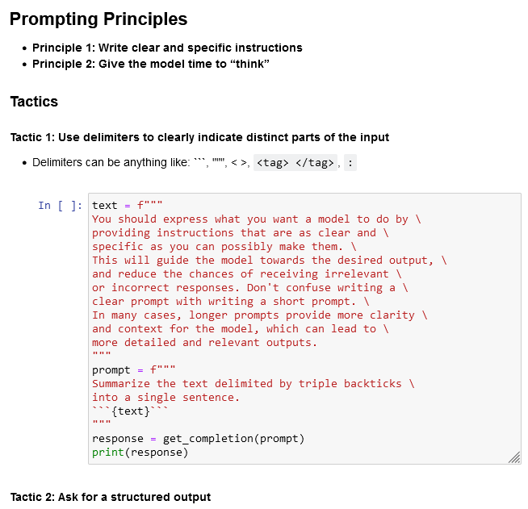
A quick word on “Prompt Engineering”
Definition (Prompt Engineering):
Prompt engineering refers to the process of designing and refining the prompts used to interact with machine learning models like ChatGPT.
It aims to optimize the way queries are phrased to achieve better responses from the model.
The idea is that subtle changes in how a question or command is presented can result in significantly different outputs.
Many shenanigans…

Slide 34
A quick word on “Prompt Engineering”
Definition (Prompt Engineering):
Prompt engineering refers to the process of designing and refining the prompts used to interact with machine learning models like ChatGPT.
It aims to optimize the way queries are phrased to achieve better responses from the model.
The idea is that subtle changes in how a question or command is presented can result in significantly different outputs.
Many shenanigans…
Learn more about with this short (1h) course? https://www.deeplearning.ai/short-courses/chatgpt-prompt-engineering-for-developers/
And this conference
https://twitter.com/petergyang/status/1665002918075043840?t=zpfQo65FZpG0m9HxHJ32iw&s=03

Slide 35
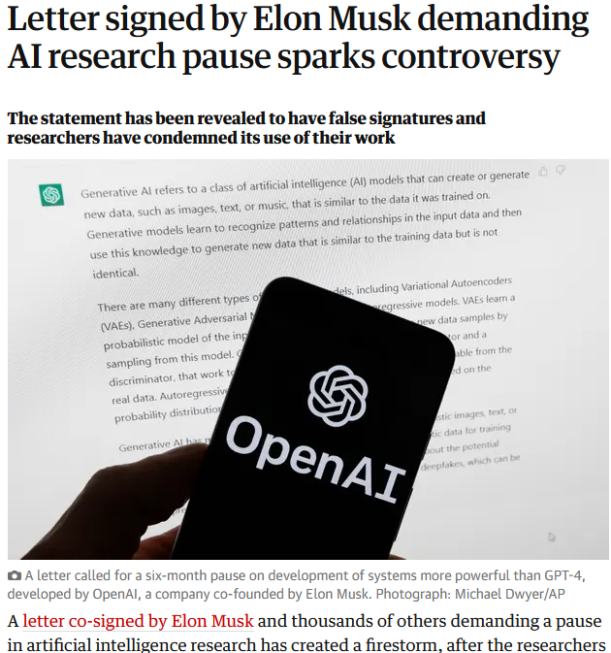
Is ChatGPT a threat?
ChatGPT is possibly the biggest AI revolution for 2022-2023.
(We typically get one every 3-5 years or so, e.g. transformers, computer vision, etc.)
Revolutions are scary and might have people freak out.
These reactions/fears are understandable, should not be mocked, but you should be smart about it.

Slide 36
Is ChatGPT a threat?
While these reactions/fears are understandable, be smart about it.
A letter that incorrectly cites papers, without checking on their authors is usually “sus”.
Many big names of DL have reported that their names appear in the list, but they never signed it.

Slide 37
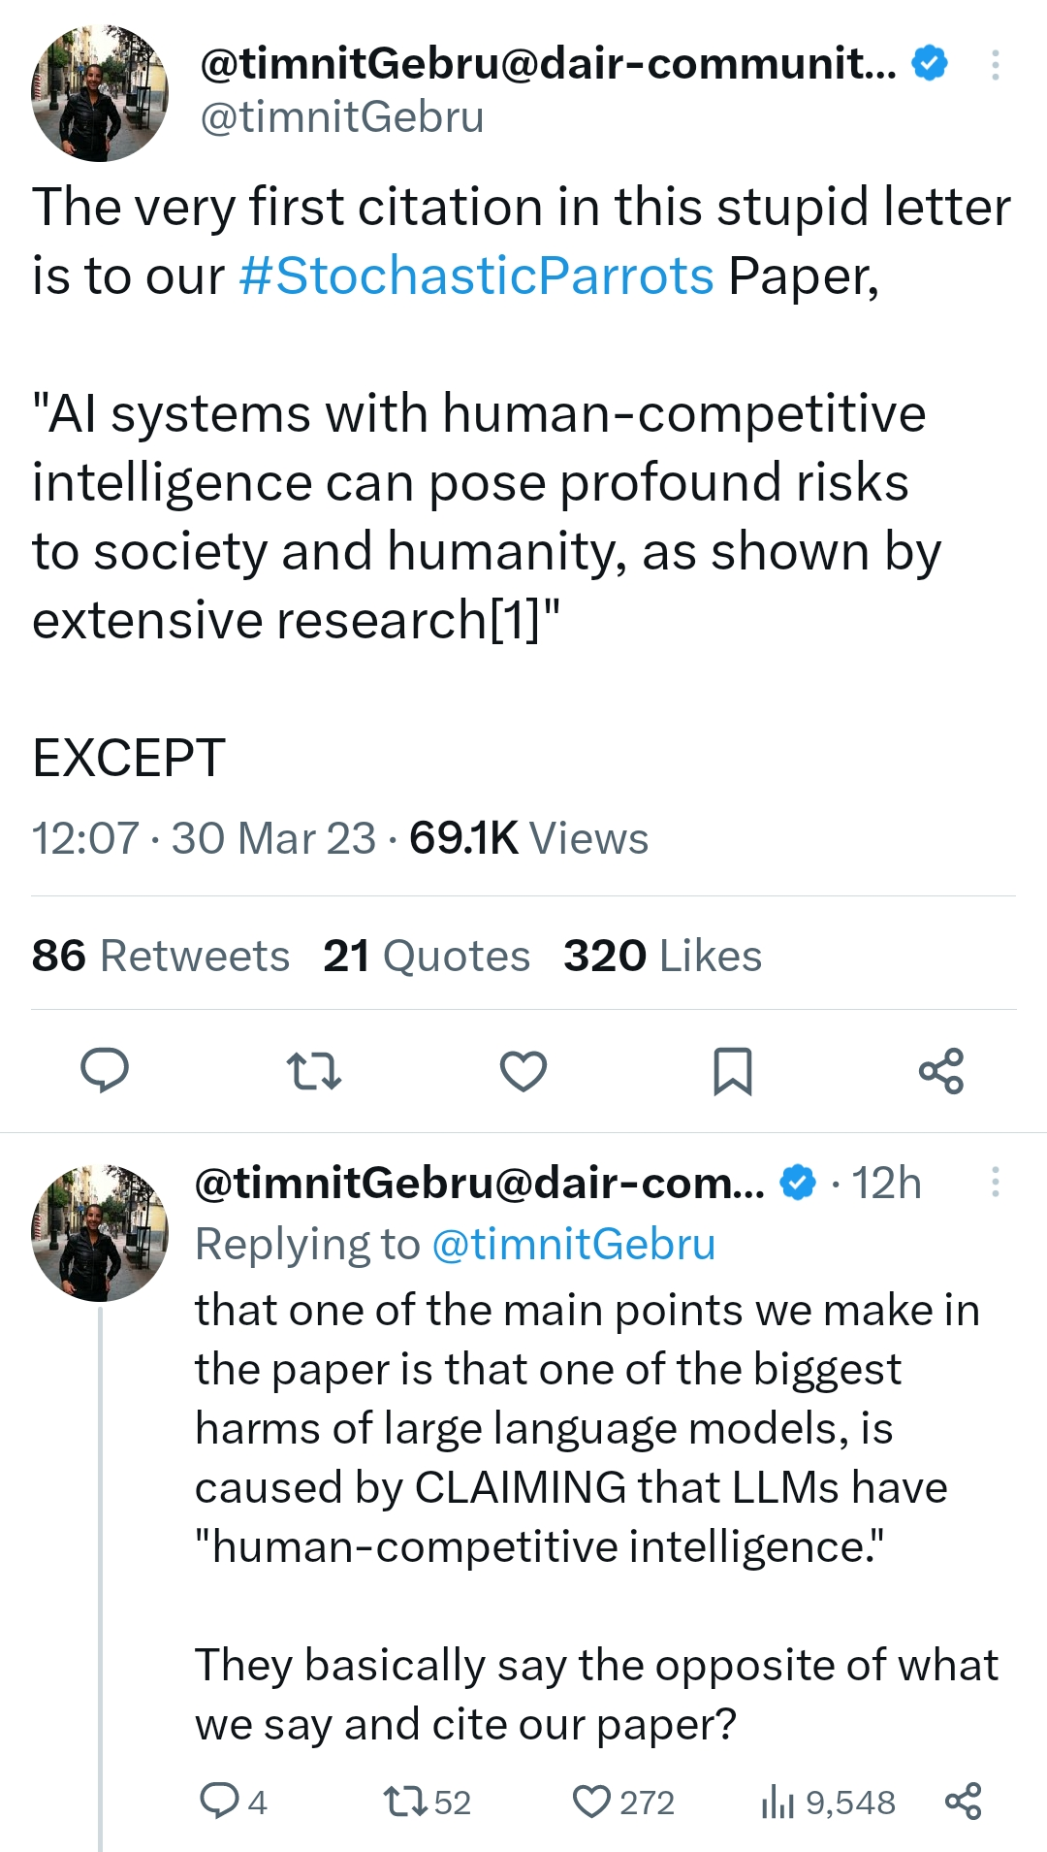
Is ChatGPT a threat?
While these reactions/fears are understandable, be smart about it.
A letter that incorrectly cites papers, without checking on their authors is usually “sus”.
Many big names of DL have reported that their names appear in the list, but they never signed it.

Slide 38
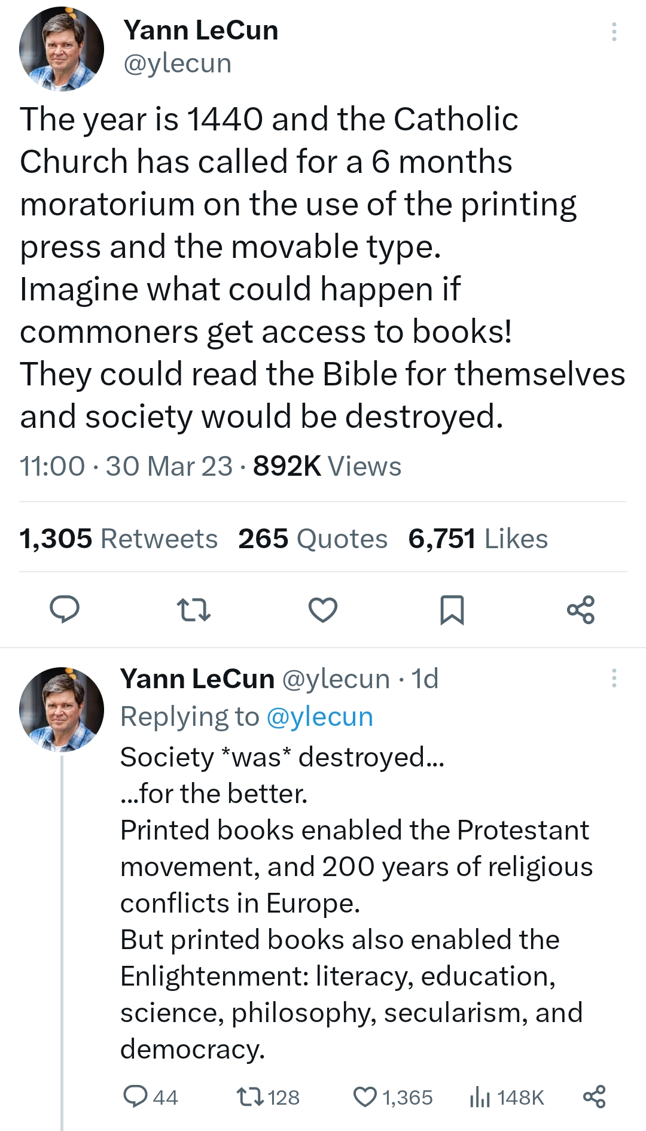
Is ChatGPT a threat?
While these reactions/fears are understandable, be smart about it.
A letter that incorrectly cites papers, without checking on their authors is usually “sus”.
Many big names of DL have reported that their names appear in the list, but they never signed it.
Just be smart and use your critical thinking.

Slide 39
In reality, the issue is…
Definition (AI alignment):
AI alignment refers to the problem of designing AI systems that reliably and safely pursue the goals and objectives set by their human creators.
The goal of AI alignment is to ensure that AI systems act in accordance with human values and do not cause harm, intentionally or unintentionally.
It involves developing AI systems that are robust, interpretable, and aligned with the preferences and values of their human stakeholders.
Achieving AI alignment is critical for ensuring that AI technology is used in ways that are beneficial to society and does not lead to unintended negative consequences. More on this on W12S1 - Explainability!

Slide 40
Is ChatGPT a threat?
My two cents: I do not think so.
If anything, I prefer to see it as an opportunity.
But I believe it will irremediably question/challenge/improve how we do things in many different fields (including teaching in universities!).
Learn more for yourself (below are some not so stupid yet accessible videos about the ChatGPT possible revolution):
Karpathy tutorial on LLMs (November 2023): https://www.youtube.com/watch?v=zjkBMFhNj_g
Some TV entertainment for the lolz (2023): https://www.youtube.com/watch?v=Puo3VkPkNZ4 https://www.youtube.com/watch?v=Sqa8Zo2XWc4

